Slide 1
Interpreting the Public Sentiment Variations on Twitter
Paper Authors: Shulong Tan, Yang Li, Huan Sun, Ziyu Guan, Xifeng Yan, Jiajun Bu, Chun Chen, and Xiaofei He
Presented by
Bairi Sandhya Rani 14CO205

Slide 2
Introduction
Twitter has become a social site where millions of users can exchange their opinion.
Sentiment analysis on Twitter data has provided an economical and effective way to expose public opinion timely, which is critical for decision making in various domains.
Reports suggest that events in real life have a significant and immediate effect on the public sentiment on Twitter.
Previous research mainly focused on modeling and tracking public sentiment in academia and industry.

Slide 3
This paper performs further analysis to mine useful insights behind significant sentiment variation, called public sentiment variation
Interpreting the possible reasons behind sentiment variation provides important decision making information.
Few instances where this analysis helps:
  If negative sentiment towards Barack Obama increases significantly, the White House Administration Office may be eager to know why people have changed their opinion and then react accordingly to reverse this trend.
  If public sentiment changes greatly on some products, the related companies may want to know why their products receive such feedback.

Slide 4
Challenges in mining emerging events
Filtering out background topics is an issue to be solved.
Keywords produced by topic modeling can describe the underlying events to some extent but not as intuitive as natural language sentences.
Reasons could be complicated and involve a number of events that are not equally important.
Hence the mined events should be ranked with respect to their contributions.
Notes:
The tweets collection in the variation period could be very noisy, covering irrelevant “background” topics which do not contribute to the changes of the public’s opinion.

Slide 5
Models for Sentiment Variation Analysis
Emerging topics discussed in the variation period could be highly related to the genuine reasons behind the variations.
When people express their opinions, often certain reasons are mentioned e.g., some specific events or topics that support their current view.
These emerging events/topics are considered as possible reasons.
Two Latent Dirichlet Allocation (LDA) based models:
  Foreground and Background LDA (FB-LDA)
  Reason Candidate and Background LDA (RCB-LDA)

Slide 6
Foreground and Background LDA
FB-LDA can filter out background topics and extract foreground topics from tweets in the variation period, with the help of an auxiliary set of background tweets generated just before the variation.
Removes the interference of longstanding background/noise topics.
The foreground set T contains tweets appearing within the variation period
The background set B contains tweets appearing before the variation period.
Such foreground topics can help reveal possible reasons of the sentiment variations, in the form of word distributions.

Slide 7
Procedure
Given the chosen topic, draw each word in a background tweet from a word distribution corresponding to one background topic.
For the foreground tweet set, each tweet has a foreground topic distribution and a background topic distribution.
For each word in a foreground tweet, an association indicator y_{t}^{i}, which is drawn from a type decision distribution λ_{t} helps in choosing a topic from θ_{t} or μ_{t}.
If y_{t}^{i} = 0, draw the topic of the word from foreground topics θ_{t}, as a result the word is drawn from φ_{f} based on the drawn topic.
If y_{t}^{i} = 1, draw the topic of the word from background topics μ_{t} and accordingly the word is drawn from φ_{b}.

Slide 8
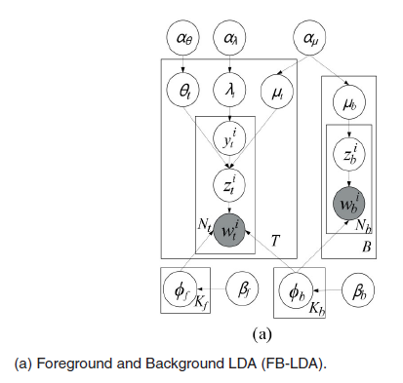
With the help of background tweets, tweets coming from the foreground set but corresponding to background topics will be filtered out.
Only tweets corresponding to foreground/emerging topics will be used to build foreground topics.

Slide 9
The most relevant tweets, called Reason Candidates C, are found which are sentence level representatives for foreground topics.
Since they are not equally important, we rank these candidates by associating the tweets in the foreground tweets set to them.
Each tweet is mapped to only one candidate.
The more important one reason candidate is, the more tweets it would be associated with.
Top-ranked candidates will likely reveal the reasons behind sentiment variations.
Notes:
Therefore find representative tweets that reflect foreground topics learnt from FB-LDA.

Slide 10
Reason Candidate and Background LDA
Accepts a set of reason candidates as input and output the associations between tweets and those reason candidates.
RCB-LDA first extracts representative tweets for the foreground topics (obtained from FB-LDA) as reason candidates.
Associates each remaining tweet in the variation period with one reason candidate.
Ranks the reason candidates by the number of tweets associated with them.
Optimizes topic learning and tweet-candidate association simultaneously.
Notes:
The association task can be done by comparing the topic distributions (obtained by topic modeling methods, such as LDA) of tweets and the reason candidates.
However, this solution is not optimal since the optimization goal of the topic modeling step does not take into account the tweet-candidate association at all.

Slide 11

Reason candidates are automatically selected using the following measure:
Each word in the foreground tweets set can select a topic from alternative topic distributions:
  draw a foreground topic from the topic distribution of one candidate
  draw a background topic from its own background distribution μ_{t}.
For each word in tweets from the foreground tweets set, a y_{t}^{i} is chosen.
If y_{t}^{i} = 0, choose an association candidate c_{t}^{i}, drawn from a candidate association distribution γ_{t} and draw a foreground topic for that word.
Process for y_{t}^{i} = 1 is as same as that in FB-LDA.

Slide 12
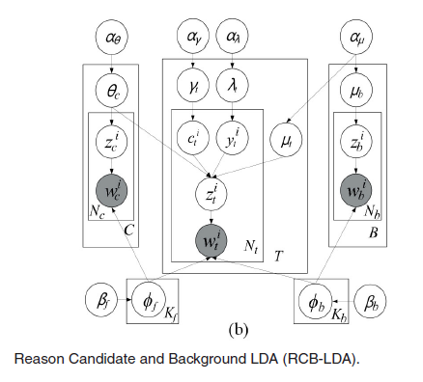
The mapping from a foreground tweet t to any reason candidate or a background topic, can be controlled by γ_{t,c} and λ_{t=0}.
If λ_{t=0} is bigger than an empirical threshold say 0.5, the tweet will be mapped to the candidate c, corresponding to the largest γ_{t,c} value.
Otherwise it will be mapped to the background topic.

Slide 13
Tracking Public Sentiment
Sentiment tracking involves the following three steps.
Extract tweets related to the target and preprocess them to make them more appropriate for sentiment analysis.
Assign a sentiment label to each individual tweet by combining two state-of-the-art sentiment analysis tools SentiStrength and TwitterSentiment.
Based on the sentiment labels obtained for each tweet, track the sentiment variation regarding the corresponding target.

Slide 14
Tweets Extraction and Preprocessing
Slang words translation:
Slang words such as lol, omg etc. may not be included in sentiment lexicons.
They are converted into their standard forms and then added to the tweets.
Non-English tweets filtering:
All non-English tweets are removed in advance.
URL removal:
These URLs complicate the sentiment analysis process therefore removed from tweets.
Notes:
Internet Slang Word Dictionary1
A tweet is considered as non-English if more than 20 percent of its words(after slang words translation) do not appear in the GNUAspell English Dictionary2.

Slide 15
Sentiment Label Assignment
SentiStrength tool:
Based on the LIWC sentiment lexicon
First assigns a sentiment score to each word in the text according to the sentiment lexicon
Chooses the maximum positive score and the maximum negative score among those of all individual words in the text
Computes the sum of the maximum positive score and the maximum negative score, denoted as FinalScore
Use the sign of FinalScore to indicate whether a tweet is positive, neutral or negative.
SentiStrength is likely to make a wrong judgement when FinalScore is close to 0.
Notes:
Linguistic Inquiry and Word Count (LIWC)

Slide 16
TwitterSentiment tool:
Based on Maximum Entropy classifier.
Uses automatically collected 160,000 tweets with emoticons as noisy labels to train the classifier.
Then based on the classifier’s outputs, assigns the sentiment label (positive, neutral or negative) with the maximum probability as the sentiment label of a tweet.
TwitterSentiment is prone to misjudge a non-neutral tweet as neutral.

Slide 17
Combined Strategy
If both tools make the same judgement, adopt that judgement
If the judgement of one tool is neutral while that of the other is not, trust the non-neutral judgement
In the case where the two judgements conflict with each other (i.e., one positive and one negative)
Trust SentiStrength’s judgement if the absolute value of FinalScore is larger than 1; otherwise, trust TwitterSentiment’s judgement.
This strategy boosts the accuracy to 69.7% effectively.
Notes:
Tools are popular but not satisfactory

Slide 18
Sentiment Variation Tracking
Previous work was to choose the variation of the total number of tweets over time as an indicator.
Current method analyzes the time period during which the overall positive (negative) sentiment climbs upward while the overall negative (positive) sentiment slides downward.
Total number of tweets is not informative any more since the number of positive tweets and negative tweets may change consistently.
Percentage of positive or negative tweets among all the extracted tweets is adopted as an indicator for tracking sentiment variation over time.

Slide 19
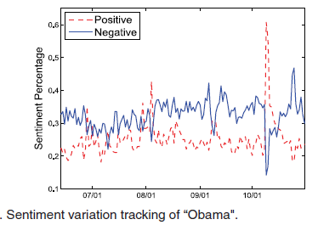
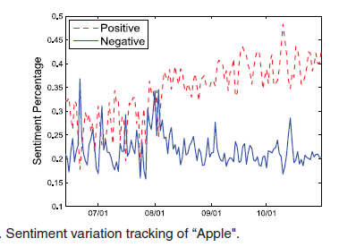
Experiments
The below figures show the sentiment curves regarding “Obama” and “Apple” from June 2009 to October 2009. Sentiment variations of these two targets are tested under proposed methods.
Notes:
Here it doesnot sum to 1 because there is also neutral option

Slide 20
Plan of implementation
I would like to implement the first two steps of tracking public sentiment followed by sentiment variation analysis using standard LDA.
The first step includes choosing a target and collecting twitter data related to the target.
This can be done using python libraries like tweepy.
Streaming APIs can be used to monitor/process tweets in real-time.
Tweets are to be preprocessed like removing emoticons, hashtags, RT, @ etc. to obtain satisfactory results.

Slide 21
The second step includes using TwitterSentiment to assign the labels.
Finally, standard LDA to predict the sentiment variation based on the labels from the previous step.
LDA is a topic model that generates topics based on word frequency from a set of documents.
LDA is particularly useful for finding reasonably accurate mixtures of topics within a given document set(here labelled tweet set).
It explains why some parts of the data are similar and what topics would create those documents in the first place.

Slide 22
Conclusion
Analyzing public sentiment variations and finding the possible reasons causing these variations.
Proposed models were evaluated on real Twitter data.
Experimental results showed that these models can mine possible reasons behind sentiment variations.
Moreover, the proposed models are general: they can be used to discover special topics or aspects in one text collection in comparison with another background text collection.

